Slide 1
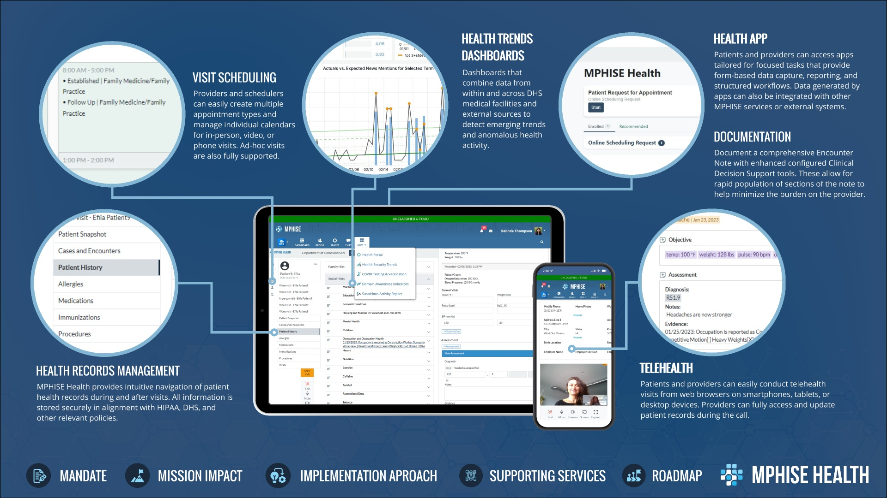


Notes:
MPHISE Health provides a medical operations capability for DHS and its public and private sector partners that rapidly adapts to evolving medical and public health needs.
The solution allows DHS healthcare providers to manage employee health records, schedule visits, manage documentation, conduct telehealth sessions, and analyze emerging health security trends. MPHISE Health also allows DHS employees to interact with their providers via a patient portal.

